Slide 1


TACTICAL COMBAT CASUALTY CARE COURSE
Module 8: Respiration Assessment and Management in TFC
MODULE 08: RESPIRATION ASSESSMENT AND MANAGEMENT IN TFC
TCCC TIER 1
All Service Members
TCCC TIER 2
Combat Lifesaver
TCCC TIER 3
Combat Medic/Corpsman
TCCC TIER 4
Combat Paramedic/Provider

Slide 2




Module 8: Respiration Assessment and Management in TFC
TACTICAL COMBAT CASUALTY CARE (TCCC) ROLE-BASED TRAINING SPECTRUM
ROLE 1 CARE
NONMEDICAL PERSONNEL
MEDICAL PERSONNEL
YOU ARE HERE
STANDARDIZED JOINT CURRICULUM
2

Slide 3













Module 8: Respiration Assessment and Management in TFC
1 x TERMINAL LEARNING OBJECTIVES
09
Given a combat or noncombat scenario, perform assessment and management of respiration and chest trauma during Tactical Field Care in accordance with CoTCCC Guidelines.
  Identify the signs and symptoms of respiratory distress. (ASM T5:E23)
  Identify the signs and symptoms of a life-threatening chest injury. (ASM T5:E24)
  Identify the signs and symptoms of open pneumothorax (sucking chest wound) in Tactical Field Care. (CLS T9:E52)
  Identify the importance and implications of vented and non-vented chest seals. (CLS T9:E53)
  Demonstrate the application of a chest seal to an open chest wound. (CLS T9:E54)
  Identify the signs, symptoms, and initial treatment of tension pneumothorax in Tactical Field Care. (CLS T9:E55)
  Demonstrate a needle decompression of the chest at the second intercostal space in the midclavicular line. (CLS T9:E56)
  Demonstrate a needle decompression of the chest at the fifth intercostal space in the anterior axillary line. (CLS T9:E57)
  Identify the signs of recurring or unsuccessful treatment of tension pneumothorax. (CLS T9:E58)
09 x ENABLING LEARNING OBJECTIVES
= Terminal Learning Objectives = Cognitive ELOs = Performance ELOs
#
3

Slide 4


Three PHASES of TCCC
Module 8: Respiration Assessment and Management in TFC
1
CARE UNDER FIRE (CUF)
/ THREAT
2
TACTICAL FIELD CARE (TFC)
WORK UNDER COVER AND CONCEALMENT
3
TACTICAL EVACUATION CARE (TACEVAC)
RETURN FIRE AND TAKE COVER
MORE DELIBERATE ASSESSMENT AND PRE- EVACUATION PROCEDURES
YOU ARE HERE
4

Slide 5
MARCH PAWS
LIFE-THREATENING
AFTER LIFE-THREATENING
P PAIN
_{A} ANTIBIOTICS
W
_{S} SPLINTING
M A
MASSIVE BLEEDING
#1 Priority
AIRWAY
R
RESPIRATION
WOUNDS
_{C} CIRCULATION
_{H} HYPOTHERMIA / HEAD INJURIES
5

Slide 6
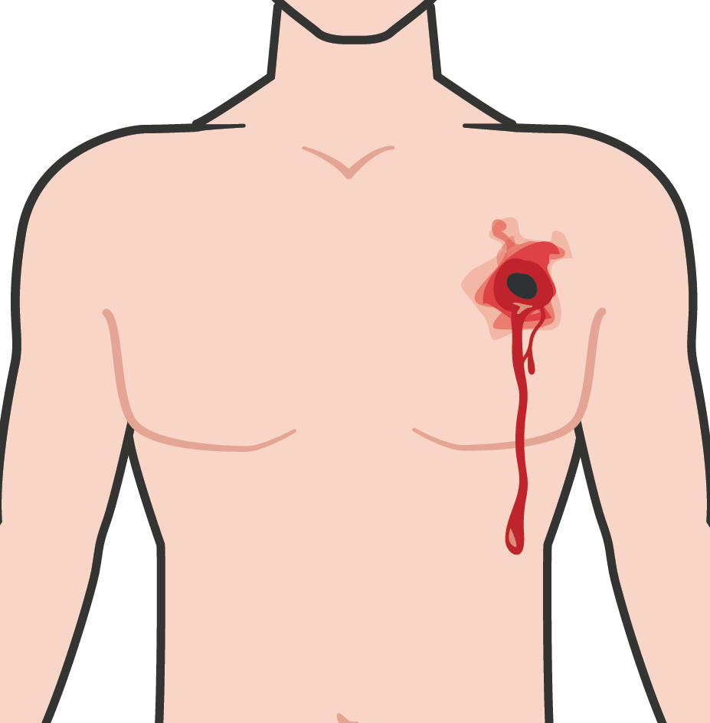
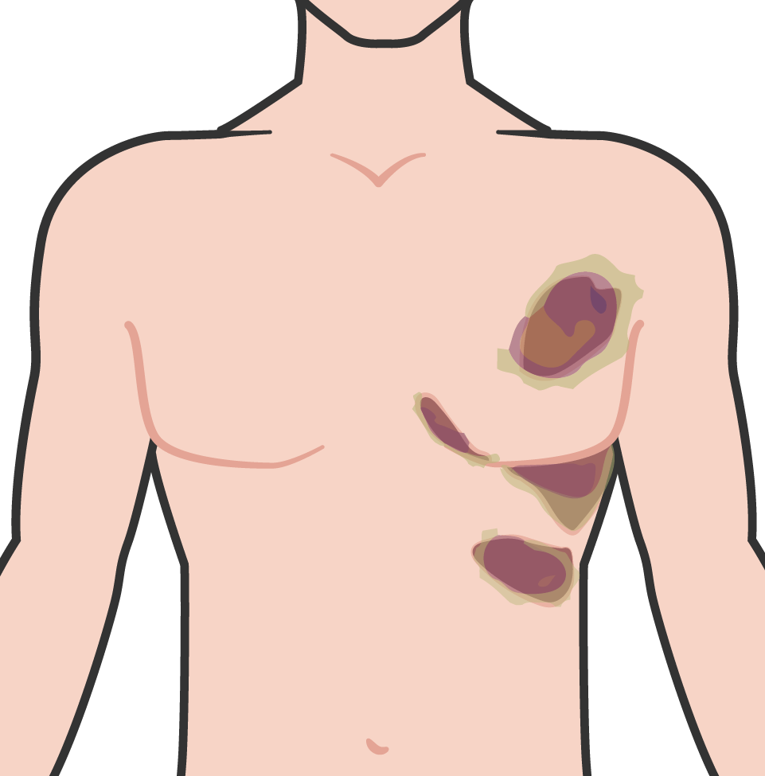

LIFE-THREATENING CHEST INJURY
Module 8: Respiration Assessment and Management in TFC
PENETRATING TRAUMA
Gunshot or shrapnel wound to the chest
BLUNT FORCE TRAUMA
Force from an improvised explosive device explosion (IED), high-impact vehicle accident (chest hitting steering wheel), etc.
Deformities, Bruising, swelling, contusions (around the chest, back or rib cage), crepitus which is felt or heard (crackling, popping, grating)
ANY deformities of the chest
REMEMBER: These injuries can lead to a tension pneumo-thorax.
This is the one of the most common causes of preventable deaths on the battlefield
M A R C H
6

Slide 7
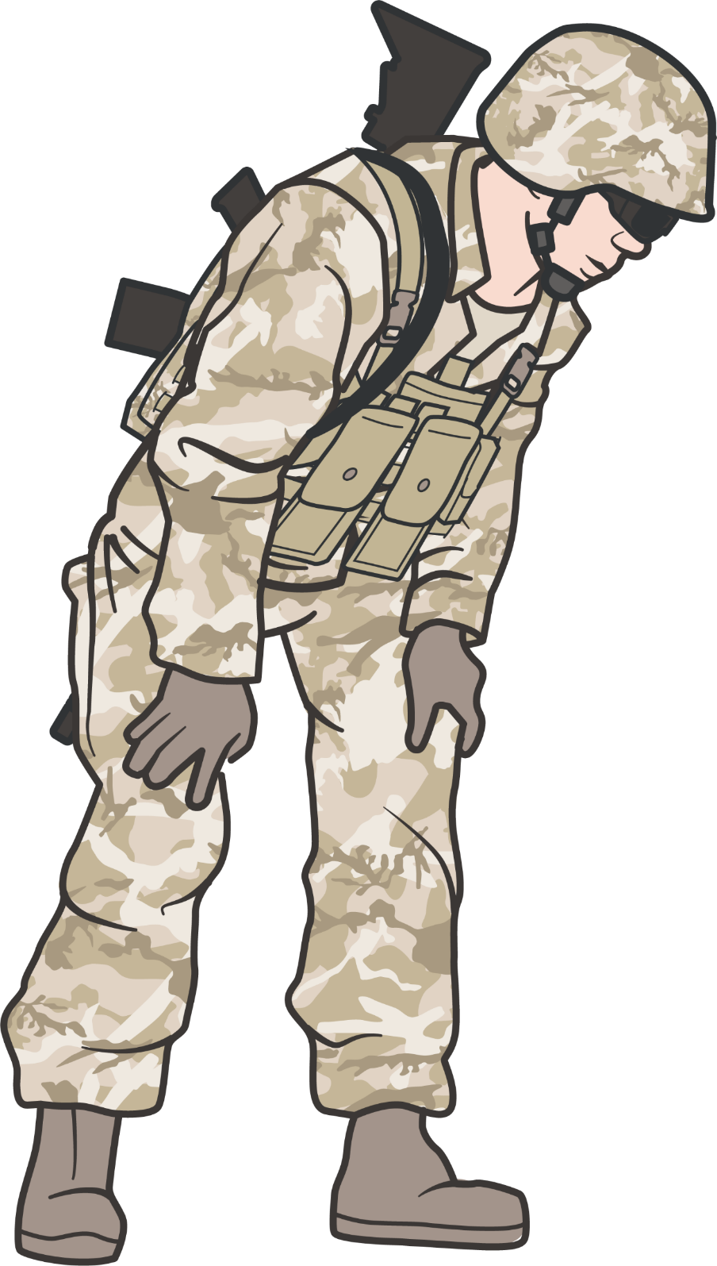
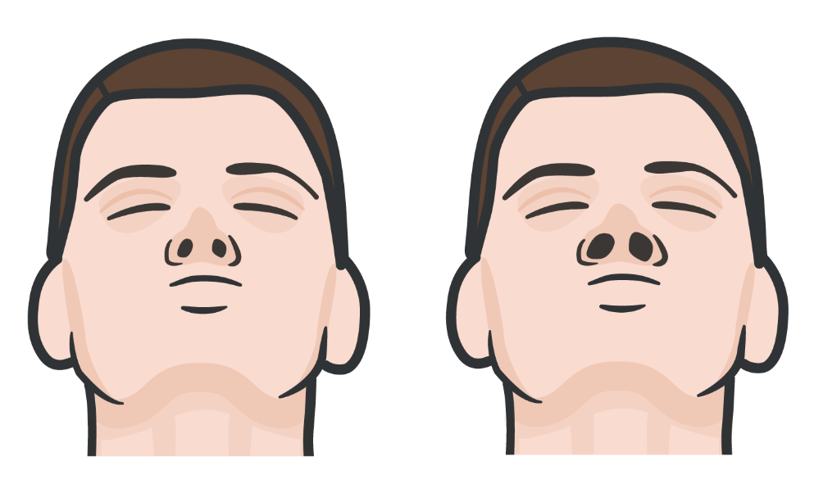
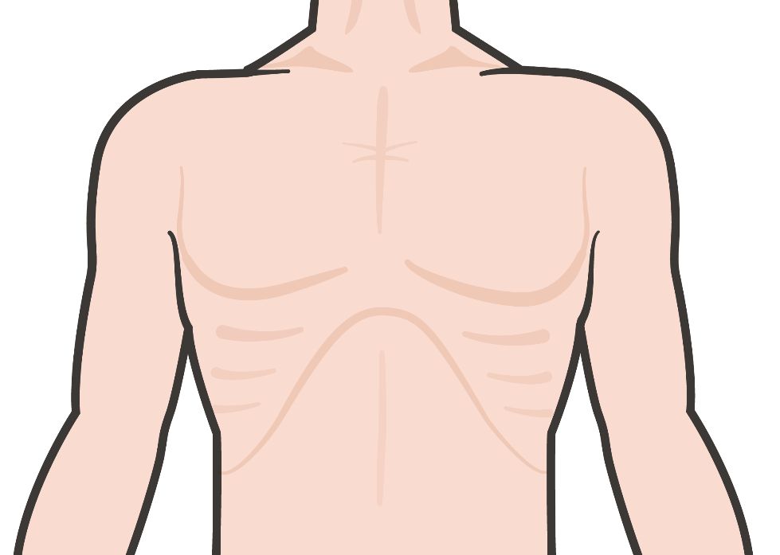


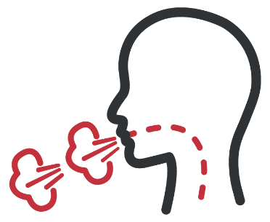
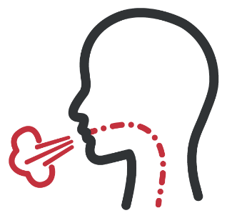


SIGNS OF RESPIRATORY DISTRESS
Module 8: Respiration Assessment and Management in TFC
RETRACTIONS
Suprasternal notch or intercostal retractions, when the skin sinks into the chest wall when the patient inhales
NASAL FLARING
The nostrils widen when the patient breaths
TRIPOD POSITIONING
The patient will sit or stand leaning forward while supporting the upper body with
hands on the knees
CONFUSION/ LIGHTHEADED
and/or AGITATION
due to lack of oxygen
TACHYPNEA
DYSPNEA
CYANOSIS
around mouth and lips
M A R C H

Slide 8
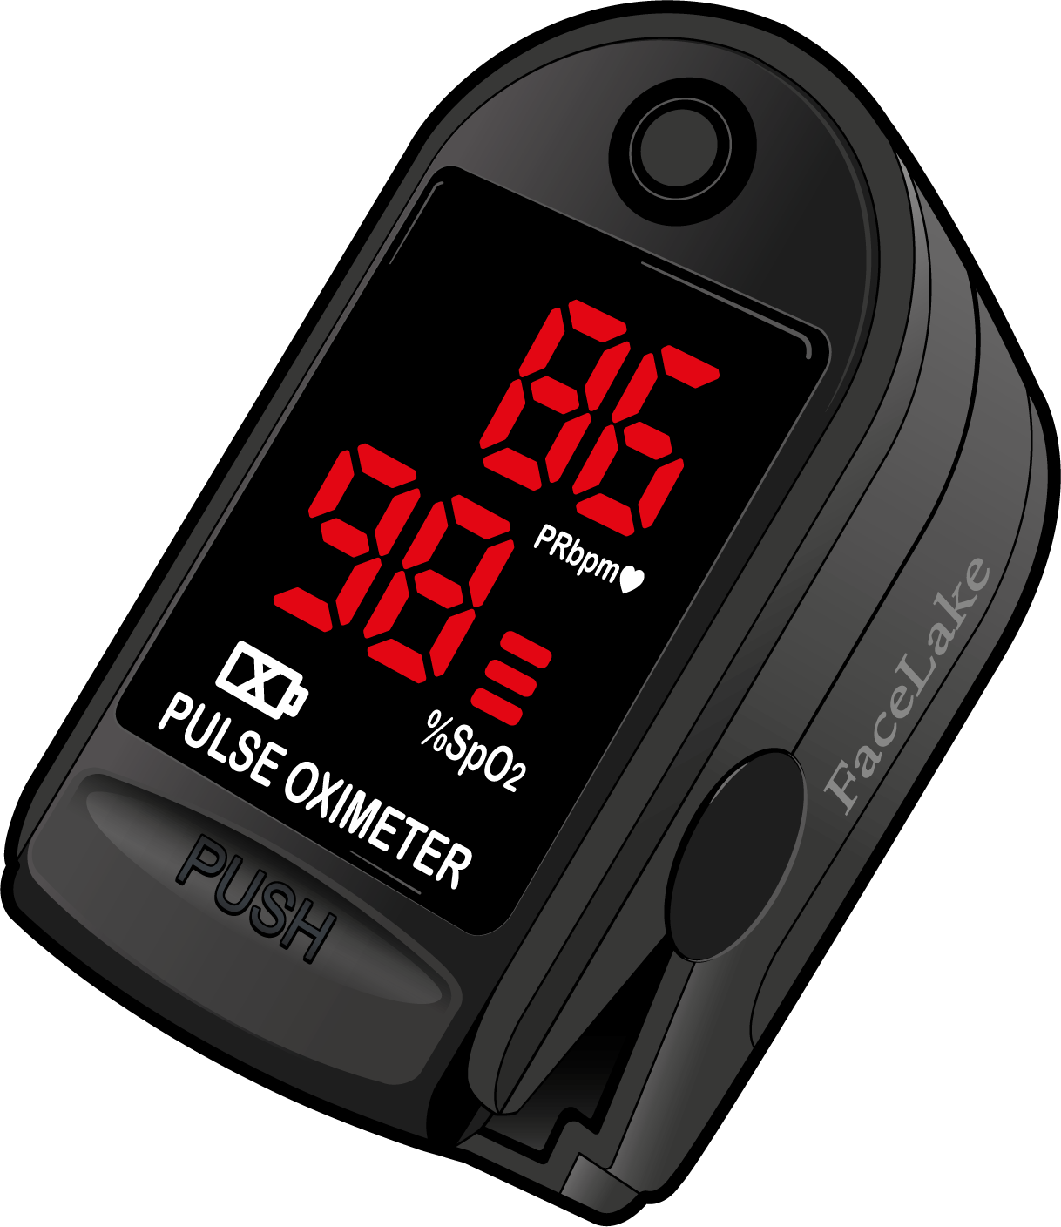
PULSE OXIMETRY
Module 8: Respiration Assessment and Management in TFC
PULSE OXIMETRY is a tool that can help you determine if your patient is in respiratory distress.
A pulse ox level that is less than 90% can indicate a casualty is in respiratory distress.

Slide 9
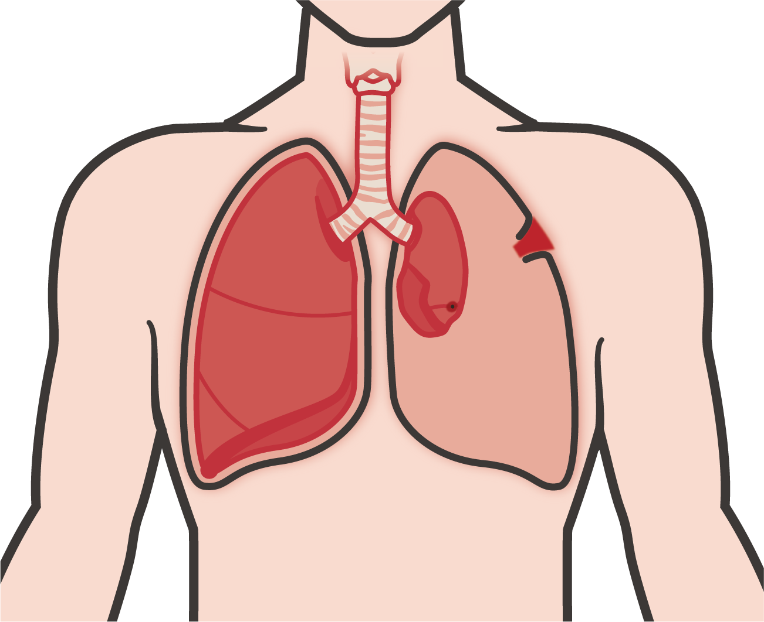
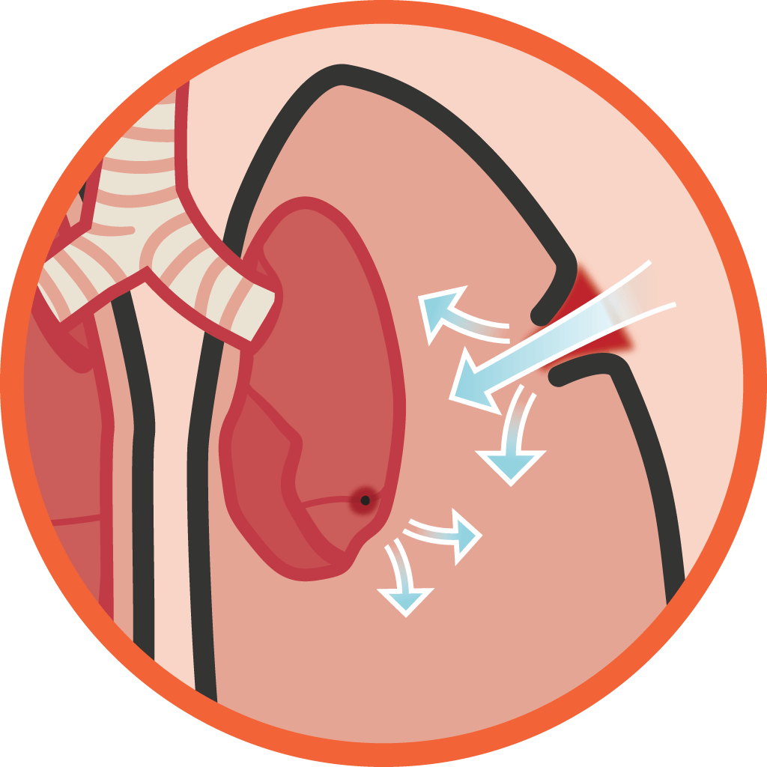
OPEN PNEUMOTHORAX
Module 8: Respiration Assessment and Management in TFC
The pleural space between lungs and chest wall naturally has negative pressure which helps the lungs stay expanded, and not collapse during exhalation
PENETRATING INJURIES TO THE CHEST WALL can be
difficult to find through the casualty’s clothes, protective gear and low-light situations
On inspiration, air enters the chest through the wound and not the normal anatomy
The affected lung cannot be fully re-inflated by inhalation
The wound can be as small 2.0-2.5 cm in diameter and can cause an open pneumothorax
Parietal Pleura
Visceral Pleura
Chest wall Injury
Air in Pleural Space
Partially Collapsed Lung
Lung Injury
M A R C H

Slide 10
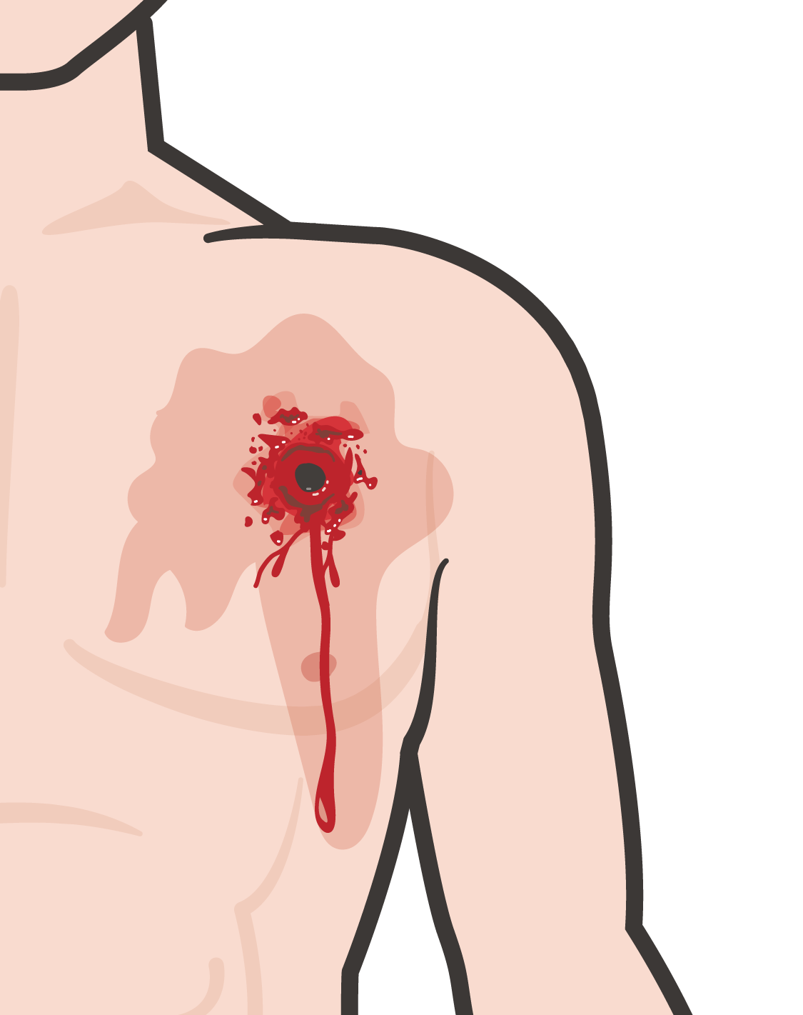
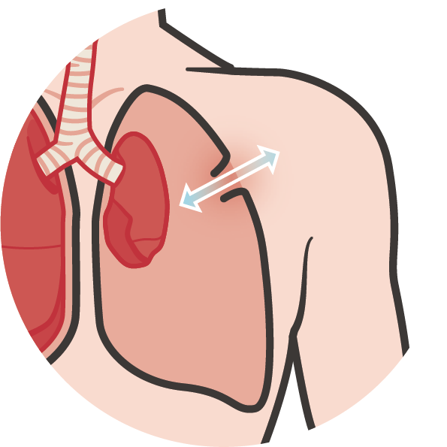
IDENTIFYING AN OPEN PNEUMOTHORAX
Module 8: Respiration Assessment and Management in TFC
Signs and symptoms of a
sucking chest wound in TFC
A casualty with an open chest wound will exhibit
ONE OR MORE of the following signs and symptoms:
Respiratory Distress
A puncture wound
of the chest
Froth or bubbles
around the injury
A “sucking” or “hissing” sound when the casualty inhales
Coughing up blood
Blood-tinged sputum
Open Pneumothorax
M A R C H

Slide 11
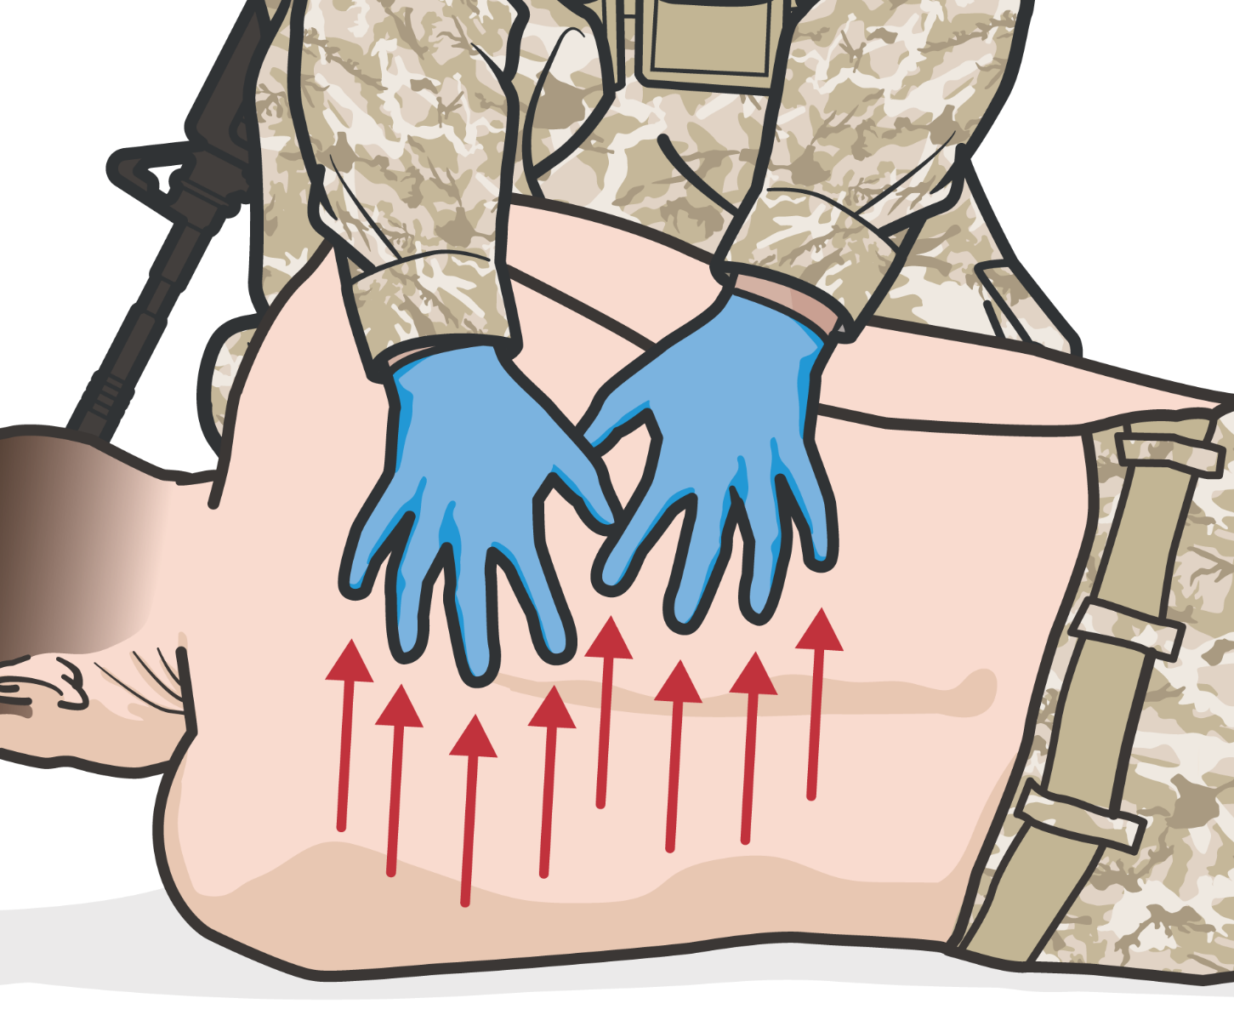
IDENTIFYING ADDITIONAL CHEST WOUNDS
Module 8: Respiration Assessment and Management in TFC
EXPOSE, UNCOVER, and CHECK/
FEEL for additional open chest wounds by using a raking motion (anterior, posterior, and axillary)
Treat them with additional vented chest seals
Raking motion
M A
R
C H

Slide 12
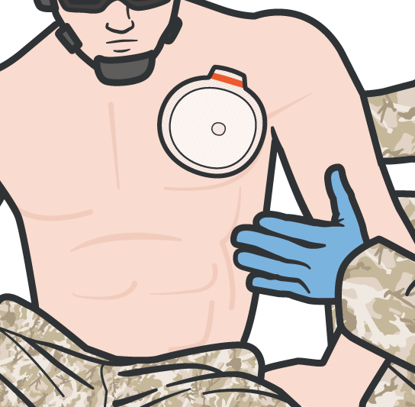

VENTED AND NON-VENTED CHEST SEALS
Module 8: Respiration Assessment and Management in TFC
For an open or sucking chest wound, prompt application
of a vented chest seal is recommended
When the casualty inhales, the plastic should be sucked against the wound, preventing the entry of air
When the casualty exhales, trapped air should be able to escape from the wound and out
the valve
The injured lung will remain partially collapsed, but the mechanics of respiration will be better
If vented chest seal is not available, a non-vented chest seal should be used
M A
R
C H

Slide 13
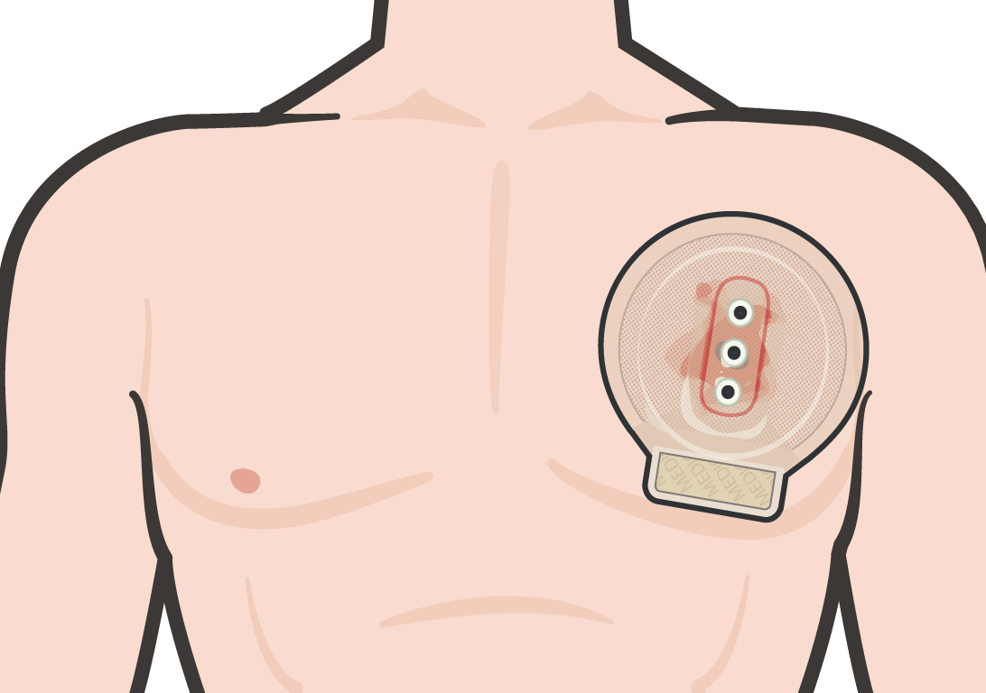
APPLYING & MANAGING CHEST SEALS
Module 8: Respiration Assessment and Management in TFC
Chest seals are for treating penetrating wounds to the chest
Place gloved hand or back of hand over the patients wound Use the casualty’s chest seal from their JFAK
Wipe excess blood, sweat or dirt away from wound
When casualty exhales, place adhesive side directly over open/ sucking chest wound, pressing firmly to create a seal
EDGES of the chest seal must extend 2 INCHES BEYOND the edges of the wound MONITOR the casualty closely and if their condition worsens, you should suspect a tension
pneumothorax. Treat this by BURPING or temporarily removing the dressing for a few seconds
M A
R
C H

Slide 14
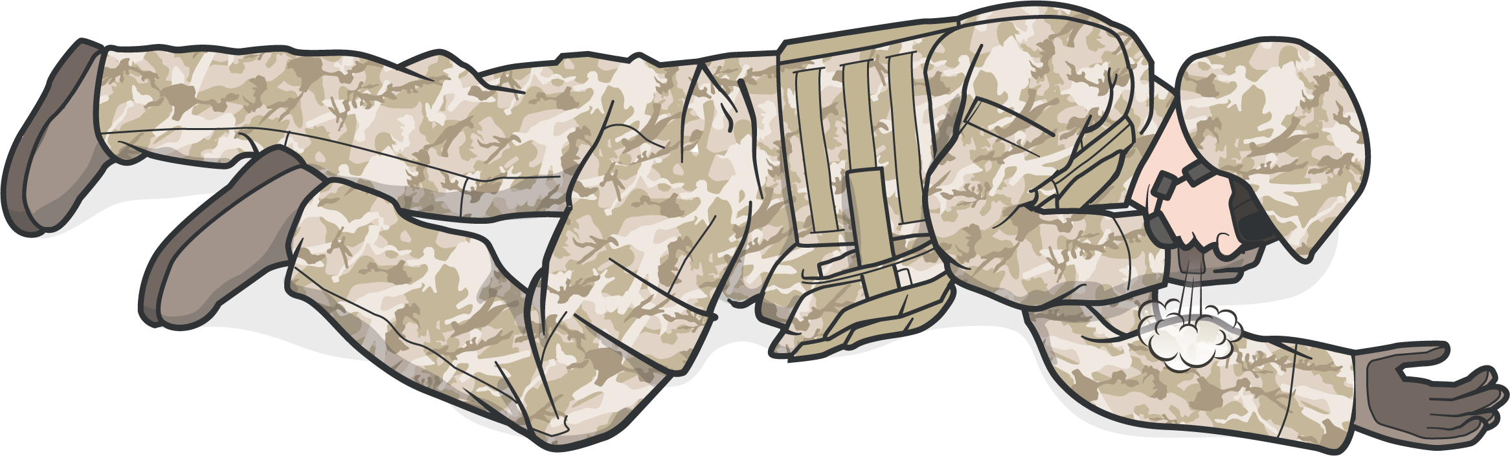
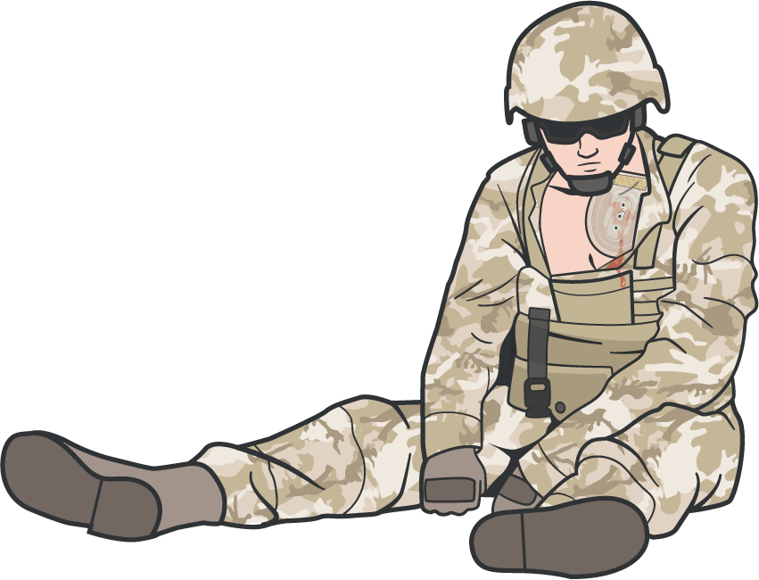
POSITION AFTER APPLYING VENTED CHEST SEAL
Module 8: Respiration Assessment and Management in TFC
If the casualty is CONSCIOUS, allow the casualty to adopt the SITTING POSITION or POSITION of COMFORT
that helps the casualty to breath.
If the casualty is UNCONSCIOUS, place the casualty in the RECOVERY POSITION with the injured side down
M A
R
C H

Slide 15

CHEST SEAL VIDEO
Video can be found on deployedmedicine.com

Slide 16

SKILL STATION
Respiration (skill)
Chest Seal Application

Slide 17
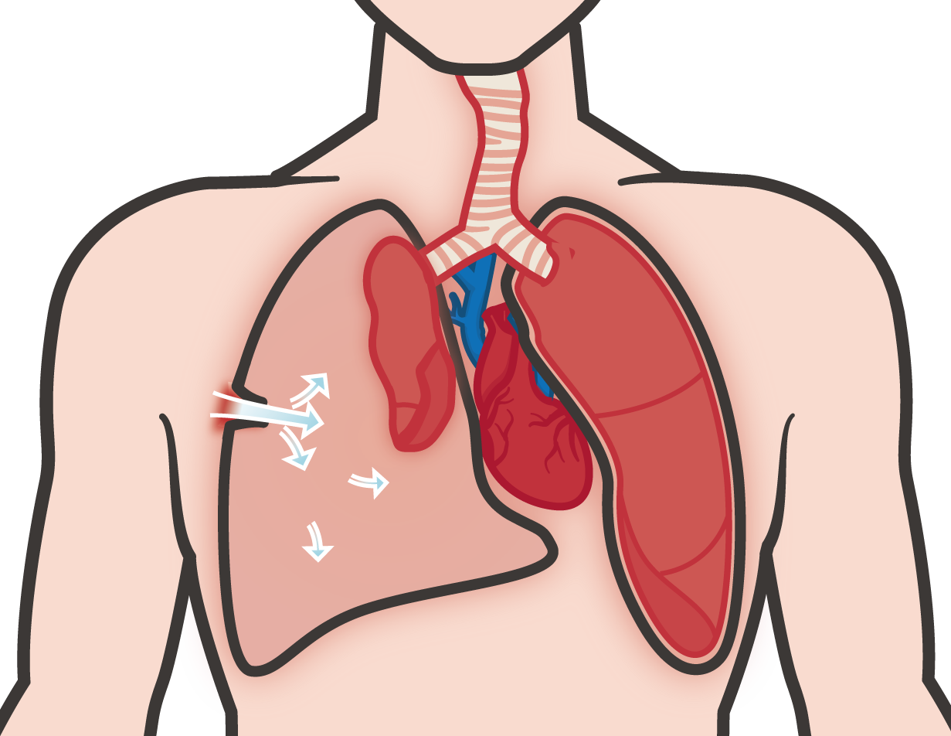

TENSION PNEUMOTHORAX
Module 8: Respiration Assessment and Management in TFC
Consider the mechanism of injury such as significant torso trauma or primary blast injury that could cause a tension pneumothorax.
Trachea deviated
(late sign)
As a tension pneumothorax develops, air enters the chest cavity through the wound WITH EVERY BREATH
Injured lung tissue acts as a one-way valve, TRAPPING more and more air between the lung and the chest wall
PRESSURE BUILDS UP AND COMPRESSES BOTH LUNGS AND THE HEART
Chest wall Injury
Left lung partially compressed
Air in
Pleural Space
Right lung and heart compressed
Air in Pleural Space
Lung tissue Injury
Right lung and heart compressed
M A R C H

Slide 18
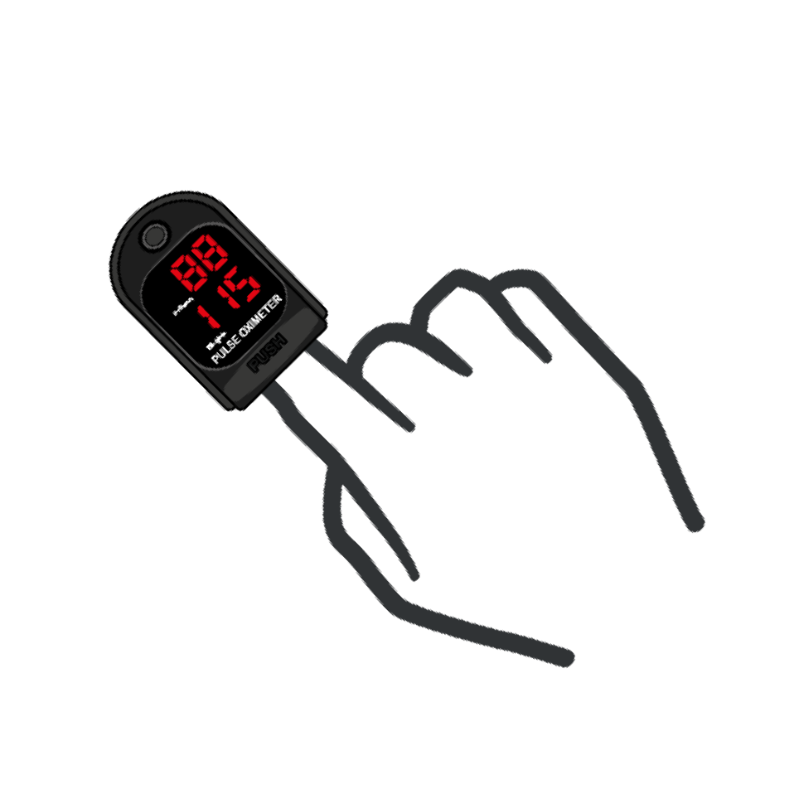





IDENTIFYING TENSION PNEUMOTHORAX
EARLY signs of a Tension Pneumothorax
Module 8: Respiration Assessment and Management in TFC
Severe or progressive
RESPIRATORY DISTRESS
ABSENT or markedly DECREASED breath sounds one side of chest
Hemoglobin oxygen saturation <90% on
PULSE OX
Severe or progressive
TACHYPNEA
LATE signs of a Tension Pneumothorax
TRACHEAL DEVIATION
SUBCUTANEOUS EMPHYSEMA
Traumatic CARDIAC ARREST WITHOUT
obviously fatal wounds
SHOCK
JUGULAR VEIN DISTENTION
MEDIASTINAL SHIFT

Slide 19
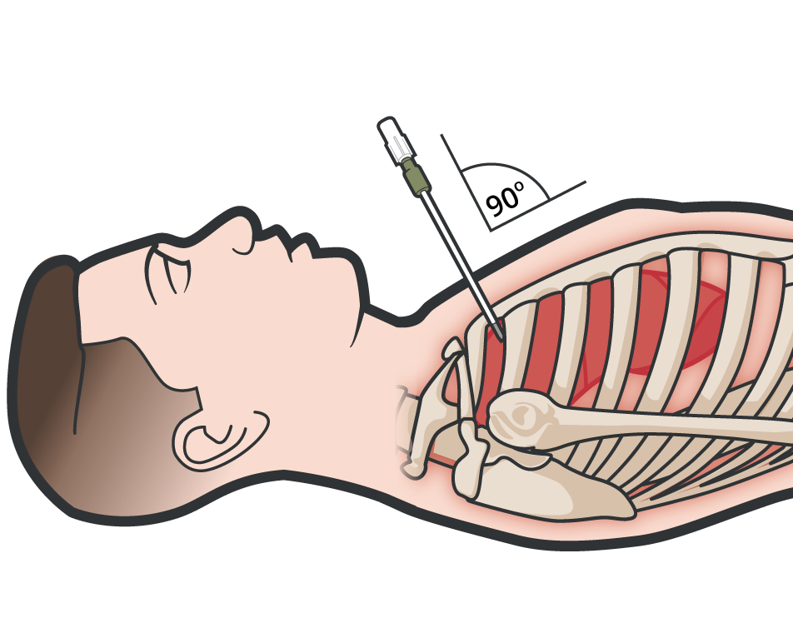
CONSIDER TENSION PNEUMOTHORAX IN TACTICAL FIELD CARE
Module 8: Respiration Assessment and Management in TFC
Despite modern body armor, tension pneumothorax remains a leading cause of preventable death on the battlefield
The recommended treatment of suspected tension pneumothorax is Needle Decompression of the Chest (NDC)
M A
R
C H

Slide 20
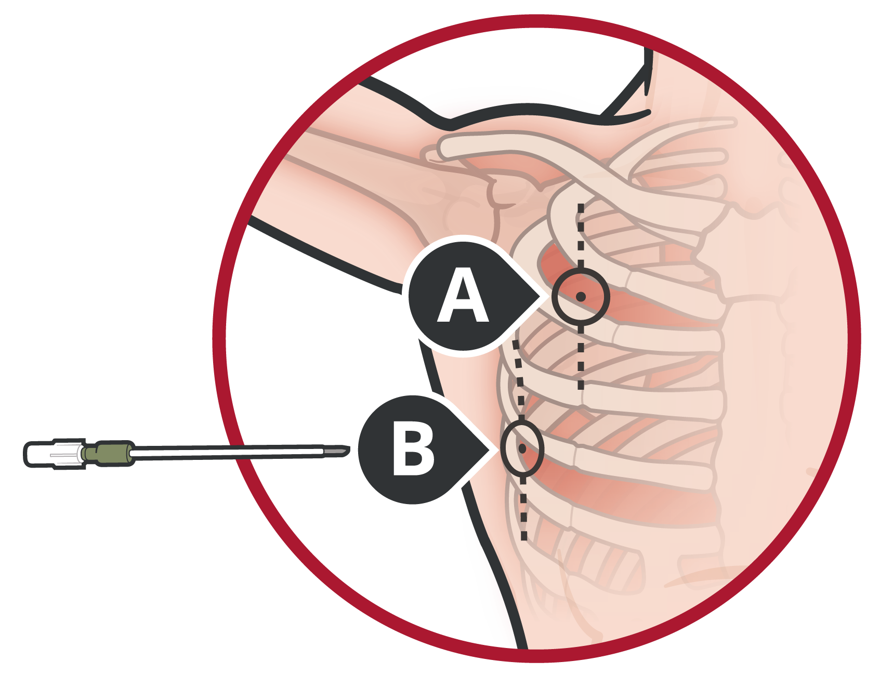
NDC SITE SELECTION
Module 8: Respiration Assessment and Management in TFC
There are two sites to choose, neither is better than the other. Use either:
A
The second intercostal space, mid-clavicular line (MCL)
or
The fifth intercostal space, anterior axillary line (AAL)
B
NEVER insert the needle medial to the nipple line for a MCL insertion.
M A
R
C H

Slide 21
POSITION AFTER NDC TREATMENT
Module 8: Respiration Assessment and Management in TFC
If the casualty is CONSCIOUS, allow the casualty to adopt the SITTING POSITION to help
keep the airway clear as a result of maxillofacial trauma.
If the casualty is UNCONSCIOUS, place the casualty in the SUPINE or RECOVERY POSITION with the injured side down
EXCESSIVE MOVEMENT may cause the NDC to become dislodged or obstructed,
EXERCISE CAUTION WHILE MOVING YOUR CASUALTY
M A R C H
21

Slide 22
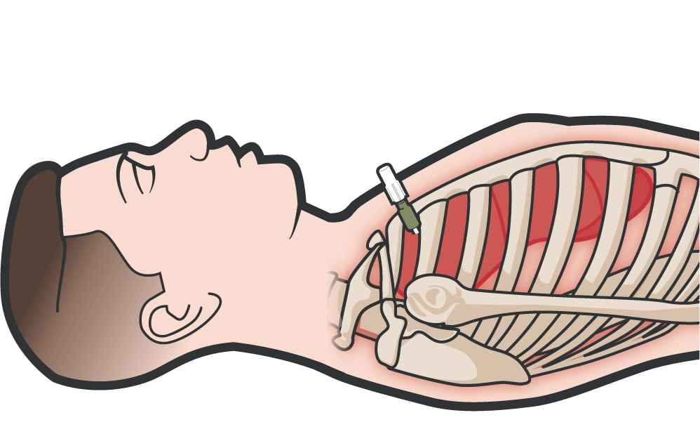
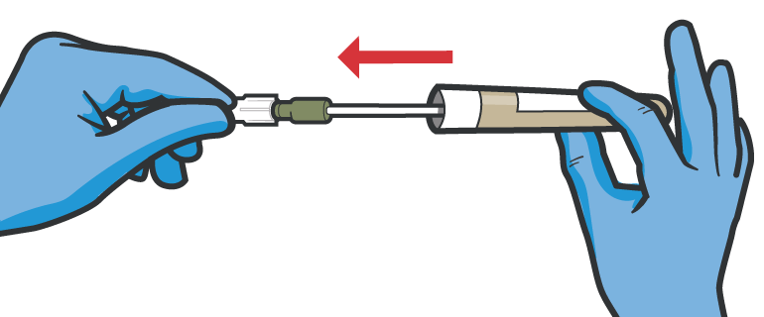
UNSUCCESSFUL TREATMENT OR RECURRENCE OF TENSION PNEUMOTHORAX
Module 8: Respiration Assessment and Management in TFC
BURP CHEST SEAL if in place
If tension pneumothorax initially responds to NDC, but symptoms later recur, then perform second NDC at the same site lateral to the original NDC
If initial NDC does not result in improvement,
perform second NDC at the alternate NDC site.
If no improvement is noted with these measures, proceed with circulation assessment and treatment following the MARCH protocol
M A R C H

Slide 23
NEEDLE DECOMPRESSION OF THE CHEST
Video can be found on deployedmedicine.com

Slide 24
SKILL STATION
Respiration (skill)
Needle Decompression of Chest (NDC)

Slide 25
RESPIRATION MANAGEMENT HIGHLIGHTS

Slide 26
SUMMARY
Module 8: Respiration Assessment and Management in TFC
RESPIRATIONS (the R in MARCH) is assessed and managed in TFC
Once you have identified a penetrating chest injury, place a gloved hand on the injury
The application of a vented chest seal can “close” an open pneumothorax
One of the most common causes of preventable death on the battlefield is tension pneumothorax, which is treatable
Either location for the NDC is acceptable, either 5th ICS AAL or 2nd ICS MCL
M A R C H

Slide 27

CHECK ON LEARNING
What is a tension pneumothorax?
How should you treat an open chest wound?
What should you do if you suspect a casualty has a tension pneumothorax?

Slide 28



ANY QUESTIONS?

Slide 29

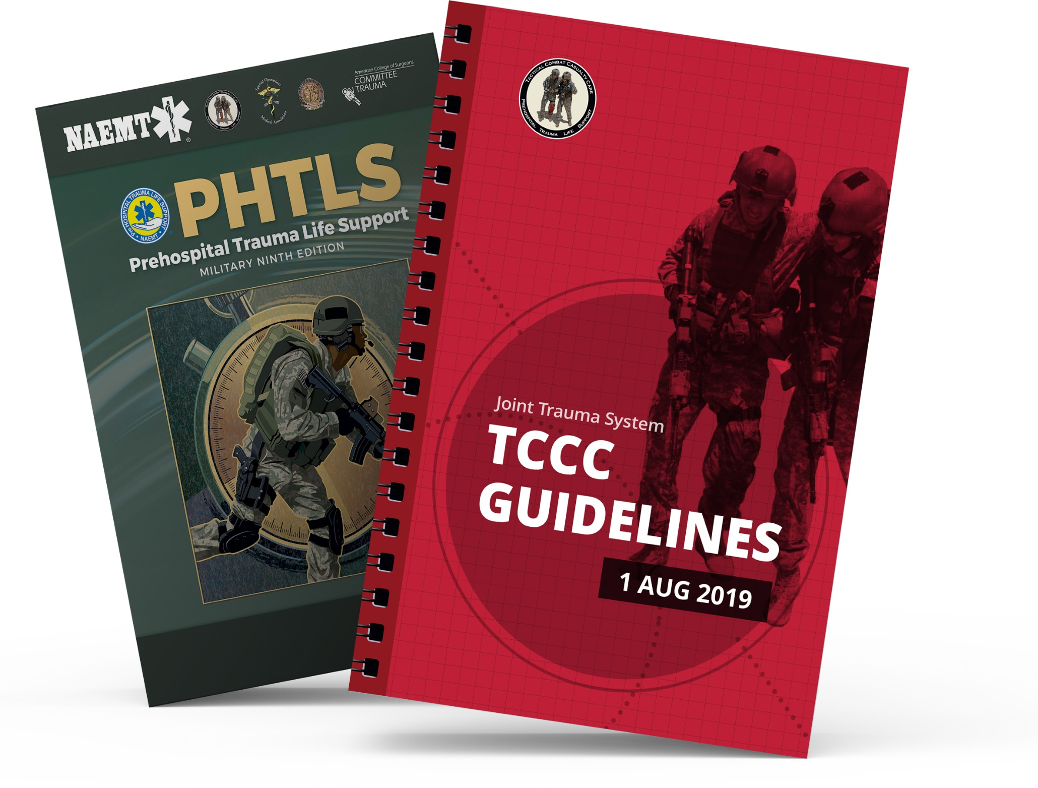
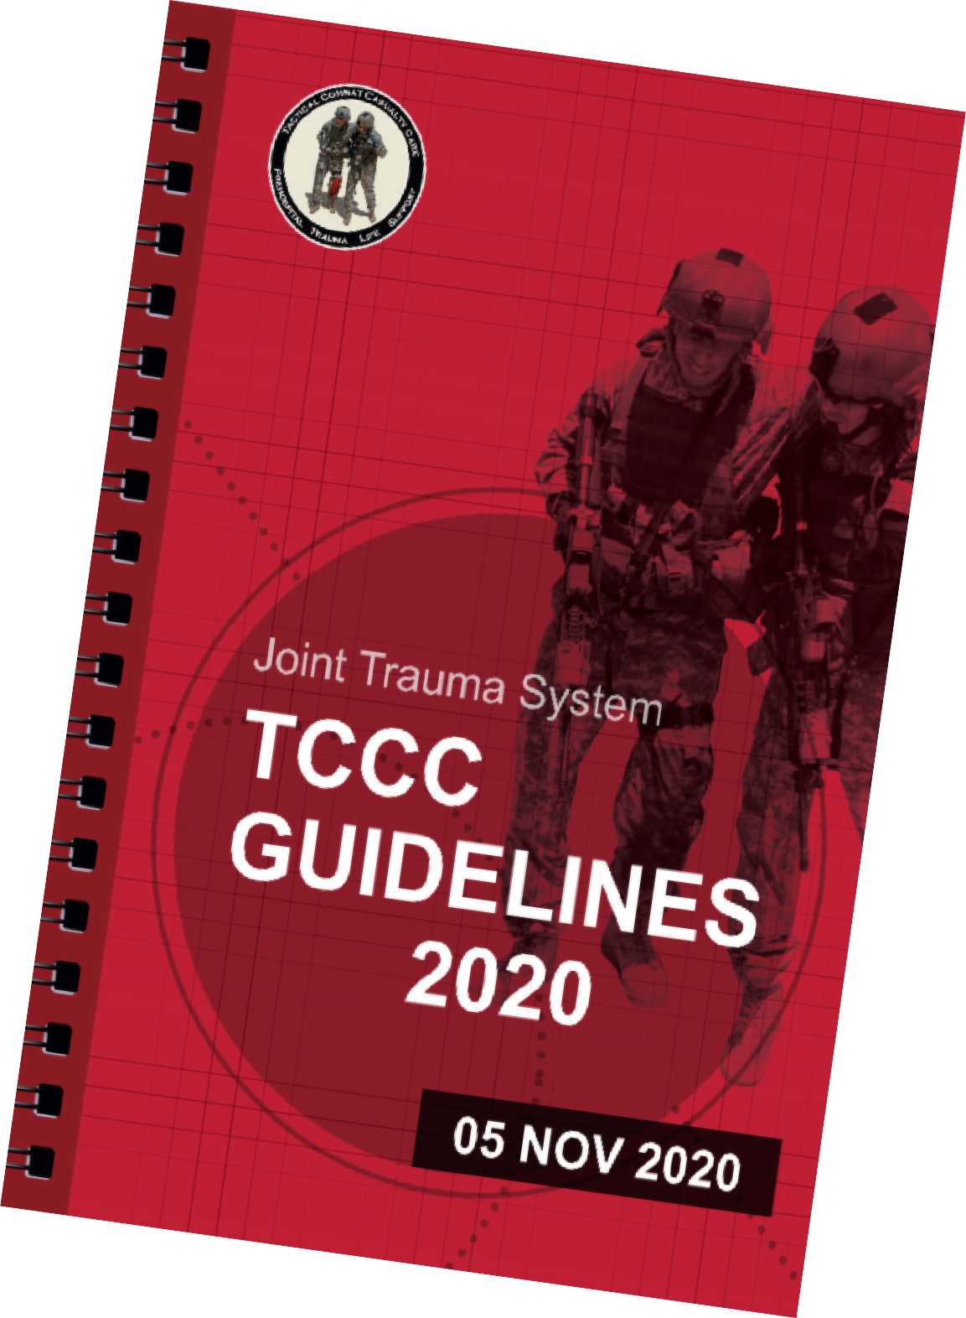
REFERENCES
Module 8: Respiration Assessment and Management in TFC
TCCC: Guidelines
by JTS/CoTCCC
These guidelines, updated regularly, are the result of decisions made by CoTCCC in exploring evidence- based research on best practices.
PHTLS: Military Edition
by NAEMT
Prehospital Trauma Life Support (PHTLS), Military Edition, teaches and reinforces the principles of rapidly assessing a trauma patient using an orderly approach.

